Slide 1
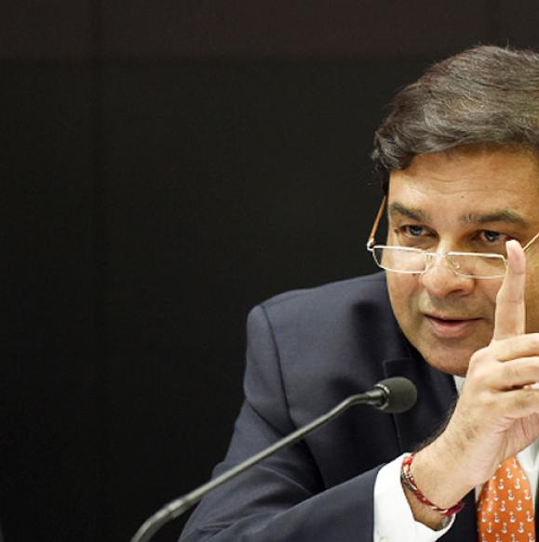

Monetary Policy: Tools
Volume of credit
Quantitative/Gen./Indirect
Qualitative: Selective, Direct
Reserve Ratios (CRR, SLR)
OMO & MSS
Rates: Bank, MSF, LAF [Repo, RR]
Selective Credit Control (SCC), PSL: Credit Rationing, Subsidy [fiscal policy]
Moral Suasion
Direct Action
+review of last one year’s policies
Consumer Credit control / EMI
Margin / LTV
Distribution of credit
…Limitations of Monetary Policy &
Mains Answer Writing Practice

Slide 2
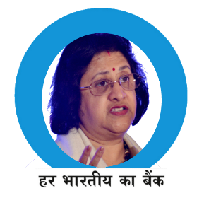
Non-transmission of monetary policy
Banks’ avg lending rates cut by 71 basis point
Repo cut by 175 basis points
Notes:
Despite a 175 basis points cut in the policy rate between January 2015 and November 2016, the reduction in the weighted average lending rate (WALR) on outstanding rupee loans for data up to September 2016 was only 71 basis points.

Slide 3

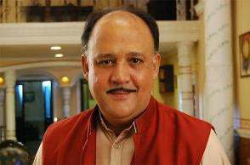
How does a Bank make profit?
Asset
Liability
Borrower
10%
Depositor
7%
+“Spread” 3%
IF more people deposited more money, then bank may reduce spread

Slide 4



Deposit Interest rates and purchasing power
1st Jan
Rs.100
Onion 20 per kg
31st Dec.
Rs.104 (SA -Demand) Rs. 107 (FD-Time)
Onion 22 per kg
Can buy 4.55 kg Can buy 4.86 kg
Can buy 5 kg
Money ▲
PP ▼

Slide 5

SBI: 5 year term-deposit
Year
2012
Nominal Interest
9.25
Minus Inflation
-11%
Real Interest Rate
-1.75
Purchasing Power ▼
Client will buy gold, real estate

Slide 6
SBI: 5 year term-deposit
Year
2012
2015
Nominal
Interest
9.25% SBI
Minus
Inflation
-11%
-5.4%
Real Interest Rate
-1.75
7.00% SBI
+1.6
8.7% KVP
2015
-5.4%
+3.3

Slide 7
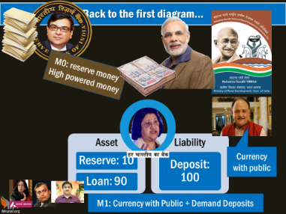
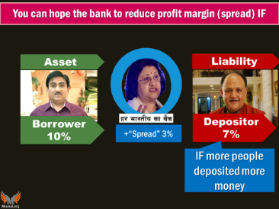
But deposit “growth” is low (vs. reform taken) because
Small savings Schemes, EPF, KVP, NSC, Post-Office deposits
Outward remittance in higher education [$1 bn/PA]
Inflation
Elections -> pull out deposits
RBI controlled inflation (2-6%) to boost Real Interest Rate
2016: Government reduced their rates
Gold-monetization schemes; Benami property act
NITI Ayog recommended their entry in India.. Need to amend UGC & AICTE Acts
Budget 2017: Donation limit, electoral bonds
Financial inclusion, SCAMs
NSEL-commodity, Chit Fund, SAHARA, Rose-Valley
Lack of financial inclusion

Slide 8
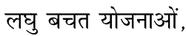
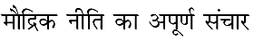
Assertion and reasoning
From survey
(A) Small saving schemes have hindered the transmission of monetary policy in recent years.
(R) the return on small savings schemes has been higher than Bank deposits
Ans. Both right, “R” explains “A”.

Slide 9

You can hope the bank to reduce profit margin (spread) IF
Asset
Liability
Borrower
10%
Depositor
7%
Spread
4%
3%
2%
IF more people deposited more money
+ high financial inclusion

Slide 10
Infact, Bank will raise the spread (profit margin) IF….
Asset
Liability
Borrower
10%
Depositor
7%
Spread
4%
3%
2%
Losses ▲
Demand for credit ▼

Slide 11
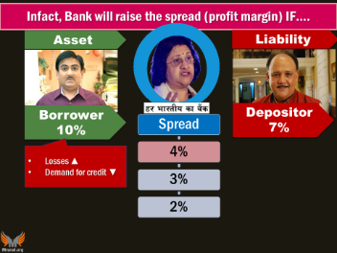
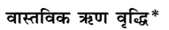
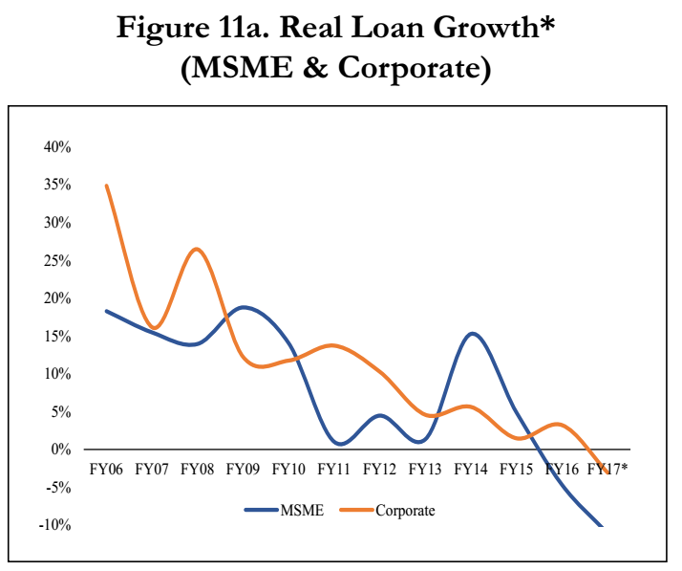

Infact, Bank will raise the spread (profit margin) IF….
Losses
If old loans turned NPA;
If farmers not repaying by bad habit, 2 drought years
Less demand from corporates
If corporates borrowing less, due to TBS, global slowdown, judicial activism, policy paralysis
Less demand from aam-aadmi
If OMC borrowing less due to cheaper crude oil; spectrum auctions not coming
Since autoloans not cheapened, less borrowing (vicious cycle)
Poor borrowing less- moneylenders

Slide 12


Who decides Lending rates?
Post nationalization: Govt. RBI interference
1991: M.Narsimhan- deregulate
2010: Base Rate
Benchmark Prime Lending Rate (BPLR)
2016: MCLR
Because banks not transmitting my rates cuts

Slide 13

What is the difference?
Base Rate
CRR Cost
Operating Cost
MCLR
Min. rate of return
Deposit Interest (Cost of Funds)
Reviewed on Bank’s discretion
Focused on avg. cost of funding
More Technicals here
Notes:
enor premium
These costs arise from loan commitments with longer tenor. The change in tenor premium should not be borrower specific or loan class specific. In other words, the tenor premium will be uniform for all types of loans for a given residual tenor.

Slide 14
Base rate system: suppose SBI decided Base Rate 10%
SBI’s | +Spread | Base rate+Spread
Car loan | 0.75% | 10.75%
Two wheeler | 8.25% | 18.25%
Education (4L) | 3.5% | 13.5%
Home (upto 75L) | 0.15% | 10.15% (10.10%W)
Home (>75L) | 0.30% | 10.30% (10.25%W)
Notes:
Banks cannot lend below Base rate.

Slide 15
Marginal Cost of Funds based Lending Rate (MCLR)
fixed loans >3 years exempt
Base Rate
CRR Cost
Operating Cost
MCLR
CRR Cost (Negative Carry)
Operating Cost
Min. rate of return
Marginal cost of funds:
Repo Rate
Deposit Interest
Deposit Interest (Cost of Funds)
Tenor premium on long term loans
Return on Networth (Cost on equity)
Rate offered on new deposits @review date
More Technicals here
Avg cost of funding
Reviewed on bank’s discretion
Marginal cost of funding, monthly review better transmission of bi-monthly policy
Notes:
enor premium
These costs arise from loan commitments with longer tenor. The change in tenor premium should not be borrower specific or loan class specific. In other words, the tenor premium will be uniform for all types of loans for a given residual tenor.

Slide 16


SBI Home Loans after MCLR & Demonetization : रामराज्य और प्रजा सुखी?
Base Rate: 9.30%
Before (2015)
After (WEF 1/4/2016)
MCLR: 9.20%
+ Spread 0.25%
+ Spread 0.25%
=Home Loan@ 9.45%
=Home loan@ 9.55%
After Demonetization in Nov’16…(1/1/2017)
MCLR 3 years: 8.15%
+ Spread 0.65%
=Home Loan@ 8.80%
-10 BASIS points
-10 BASIS points
-105 BASIS points
-65 BASIS points
Repo: 175 basis points
BASE/MCLR: 115 basis points
Final customer: 75 basis points
Notes:
1000 rs. Lesson 10 lakh loan
Women- its 20bps
Marginal Cost of Funds based Lending Rate (MCLR)
Exempt: Loans >3 year tenure
Existing customers can shift to this system with caveats.
SBI's new MCRL rate: 9.2% for 1 year, 9.3% for two year, 9.35% for three years.

Slide 17

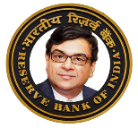
Non-transmission of monetary policy
Banks’ avg lending rates cut by 71 basis point
Repo cut by 175 basis points
Notes:
Despite a 175 basis points cut in the policy rate between January 2015 and November 2016, the reduction in the weighted average lending rate (WALR) on outstanding rupee loans for data up to September 2016 was only 71 basis points.

Slide 18



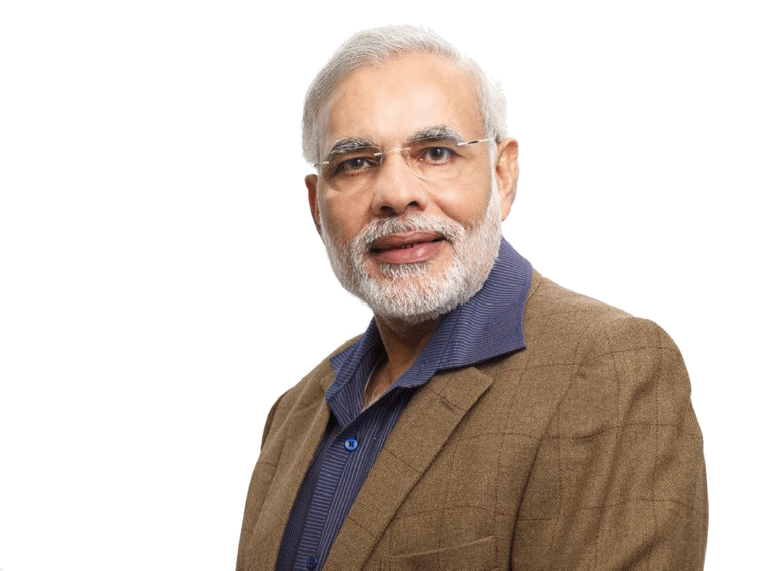
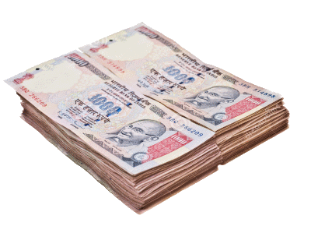
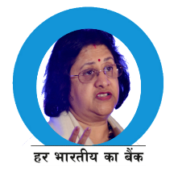




Limitation of Monetary policy..
M0: reserve money
High powered money
Asset
Reserve: 10
Liability
Deposit: 100
Loan: 90
Currency with public
M1: Currency with Public + Demand Deposits

Slide 19
Limitation of Monetary policy..
M0: reserve money
High powered money
Lending rates not decreased
Even if RBI lowers SLR, CRR, still:
+ NPA, fall in corporate borrowing ▼.
Rs.90 kept
Fin. inclusion
KVP,NSC,
Chit Fund, Scams
Gold, real estate
Study abroad
Asset
Reserve: 1
Liability
Deposit: 10
Loan: 9
M1: Currency with Public + Demand Deposits

Slide 20


Limitation of Monetary policy..
M0: reserve money
High powered money
Rs.90 kept
If bank rate, Repo 8% 1% => overleveraging and debt ever greening by corporates
+Cooperative banks issues
Evergreening of loans!
Asset
Reserve: 1
Liability
Deposit: 10
Loan: 9
Repo?
M1: Currency with Public + Demand Deposits

Slide 21
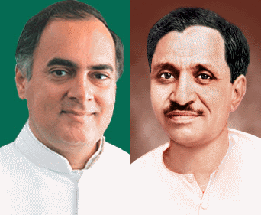

Limitation of Monetary policy..
M0: reserve money
High powered money
Asset
Reserve: 10
Liability
Deposit: 100
Loan: 90
Repo Loans
Leaked Rs.2000
=inflation▲
Although 7th PC and OROP unlikely to have this, says RBI
400
4000
3600
M1: Currency with Public + Demand Deposits

Slide 22
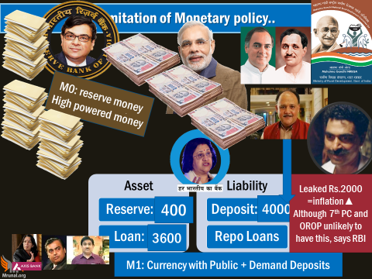
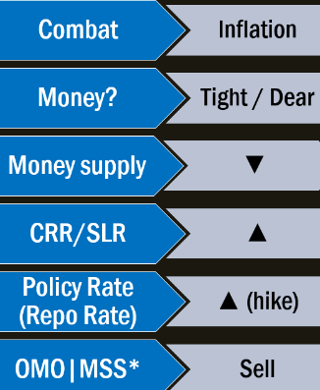
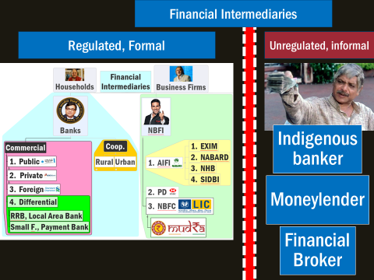
MP is a catalyst, but NOT panacea for economic growth. Structural reforms required.
economy is not 100% monetized
Non-monetized “land resources”: minerals, factories
Labour is not always a 'salable commodity' in monetary terms: 1) agri-labourers paid in kind 2) women in rural India
Unorganized sector: Higher "Credit" doesn't improve level of productivity, !(R&D).
“Hawkish” policy= SME can’t get cheap loans ☹

Slide 23
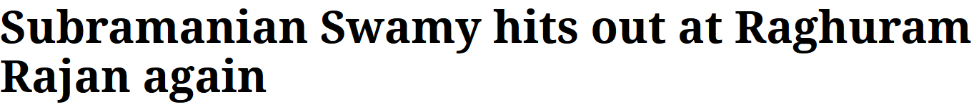
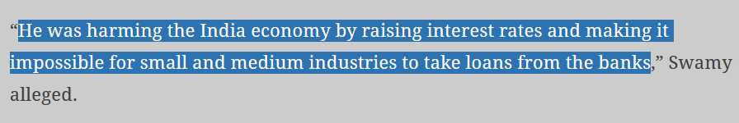
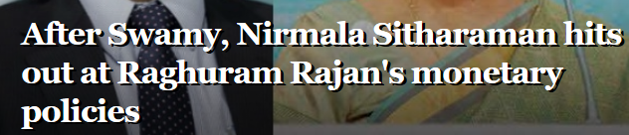
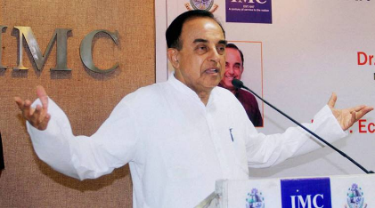
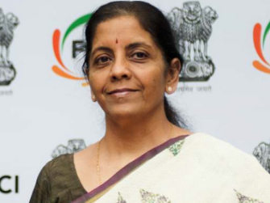
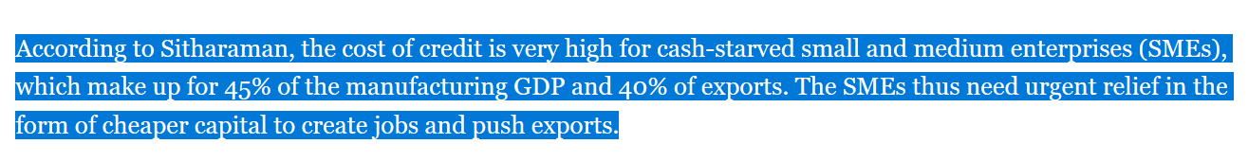

Slide 24
Suppose RBI reduces repo rate by 2%
Asset
Repo Rate
6-2=4%
Bank rate=4.5%
Borrower
6%-6.5%
Spread
2%
Liability
MSME happy,
Consumer Demand boost …BUT
Then bank will not this much interest on deposit! it may go down to 4%...then depositor will shift to gold, real estate..So, “You can’t have it both ways”
Depositor
7(FD)%

Slide 25
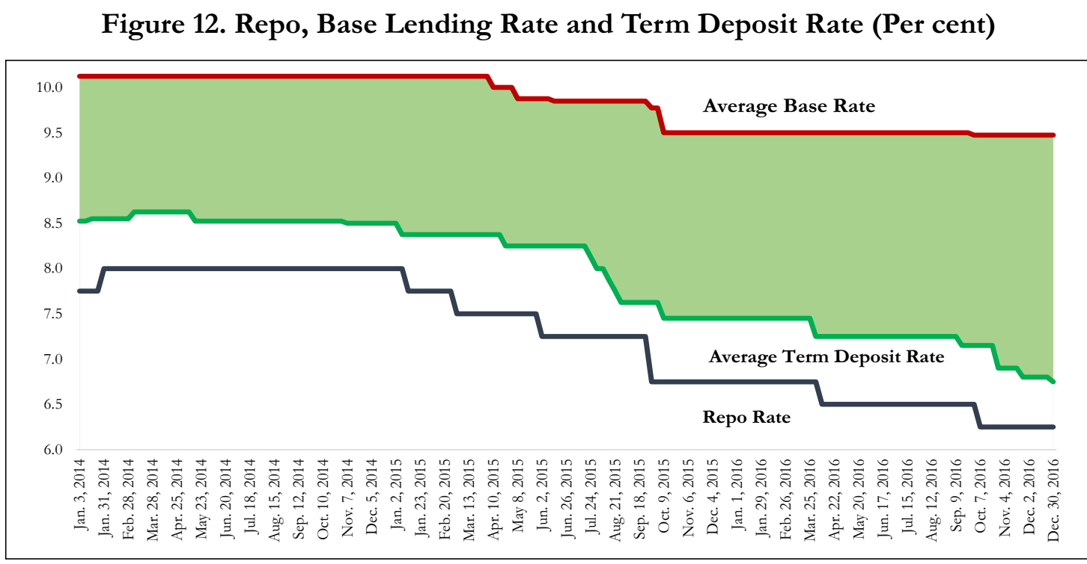
If repo ▼then banks immediately reducing deposit rates
But not reducing the lending rates! [or hiking “SPREAD”]

Slide 26
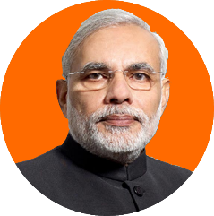
Modi also knows you can’t have it both the ways!
Demonetization-> excess NDTL, hope that lending rates will ▼ (MCLR) ☺
But savings rates may also ▼ ☹
So, to protect senior citizens- for deposits upto Rs7.5 lakh, they will be guaranteed 8% interest rate for 10 years.
Notes:
Senior citizens can receive this interest income every month.

Slide 27
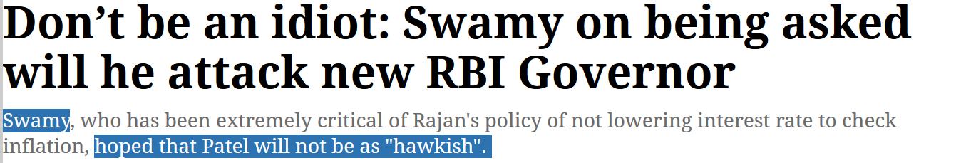
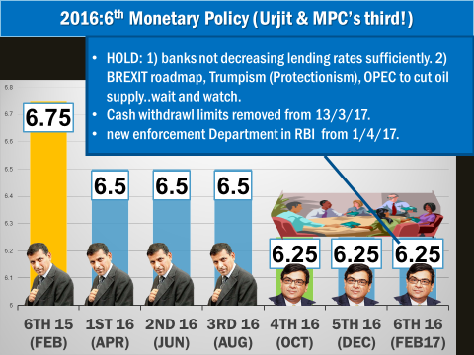
8-9%
+Supply side variables out of control : Monsoon, Crude Oil.
+Demand side variables out of control:
Post-GFC foreign demand

Slide 28
Structural bottleneck: Fiscal repression
Banks
SLR: Cash, gold, G-Sec
PSB: forced to invest in G-Sec, even beyond SLR
If G-Sec 8%, bank will pay you <8% only
LIC, EPFO
Large chunk of premium in G-Sec only
Optimal return..x
Household
Deprived of optimal return
Business Firms
“Crowding out”: deprived of cheap loans

Slide 29
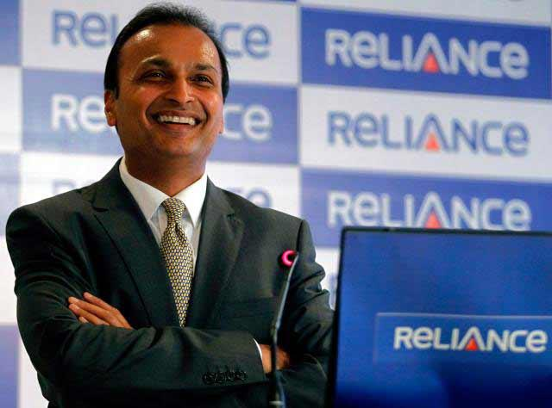
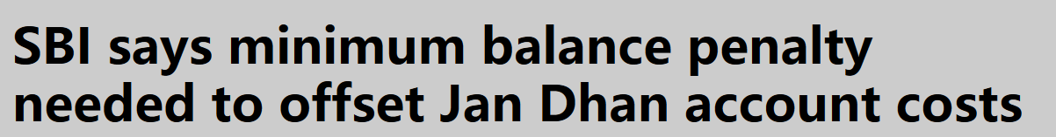
End result: disintermediation of banks
Asset
Liability
Informal lenders
Spread
4%
3%
2%
Gold, real estate
IPO, ECB, Bond,
C-Paper

Slide 30
Monetary Policy: Tools
Volume of credit
Quantitative/Gen./Indirect
Qualitative: Selective, Direct
Reserve Ratios (CRR, SLR)
OMO & MSS
Rates: Bank, MSF, LAF [Repo, RR]
Selective Credit Control (SCC), PSL: Credit Rationing, Subsidy [fiscal policy]
Moral Suasion
Direct Action
+review of last one year’s policies
Consumer Credit control / EMI
Margin / LTV
Distribution of credit
…Limitations of Monetary Policy &
Mains Answer Writing Practice

Slide 31
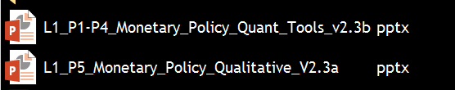
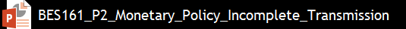
Old PPTs are “demonetized” and “Decontentized”

Slide 32
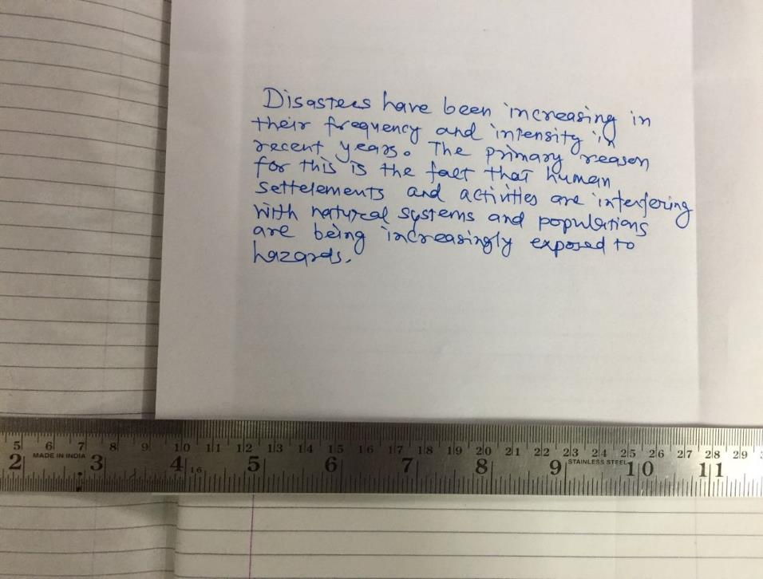
BES171: Mains Answer Writing Practice
1”
1”
So you can self review against model answer
Write Answer
Model Answer framework
Topic Taught
8 line x 40 words.
= ~1 page = 120 words.
2 pages Only text
2.5 pages: Text + diagram
Notes:
No practice in blank page= Cramming in last paras of QCA

Slide 33
Mains answer writing for 200 words and essays
Introduction
Body
Conclusion
Define > Origin > Data
Finding: examine, assess, analyse etc.
Summary: discuss, describe, elucidate, narrate, outline etc
Slangs, abbreviation; subject-verb; pan-ki-dukaan extreme words
Hinglish, Gujlish…x; chaste words

Slide 34

Answer in 200 words
"Monetary policy is both a catalyst (उद्दीपक) and an impediment (अवरोधक) to India's growth story." Examine critically.
“भारत की विकास-गाथा में मौद्रिक नीति एक उद्दीपक भी है और एक अवरोधक भी है।" गंभीररूप से विश्लेष्ण करे.
Pause
Time: 8 minutes, content: 2 pages

Slide 35

Poor structure: “Critically examine” MP as catalyst/impediment
introduction: “Origin”
Post-GFC hawkish MP, despite fall in inflation
Fragmented ideas
Repo rate how it helps. But not passed on. So MCLR but even after Demonetization not enough cuts.
SME deprived of cheap Loans.
PSL: noble aim, but big farmers getting loans. ISS, debt waiver not reaching small marginal……
Conclusion..
Yes yes. Both catalyst and impediment.
Private bank license, white label ATM, rural branching
NPA, big corporates ran away with all money
Paan ki dukan
Deviated from main topic
Notes:
Ye rahe gyaa….woh rahe gyaa…

Slide 36
“EXAMINE” Monetary Policy: catalyst & impediment?
Introduction: Define / Origin / Data
macroeconomic policy designed by Central Bank….
Body#1: Catalyst, Really? How?
Body#2: Impediment, Really? How?
Conclusion: Critically examine
Finding/ judemental: catalyst yes, impediment- not by itself , but some structural issues.
Hawkish policy: cheap loans? But who was responsible?
CRR, SLR, Repo. No need to write all type of tools
PSL: new cat: s/m farmers, renew energy, social infra
Doesn’t mean “CRITICIZE”
You can agree, disagree, partially agree or disagree but after “examining” the facts

Slide 37

Monetary Policy: Introduction: Define /origin /data
Not RBI, because definition is universal.
M.P. is a macroeconomic policy
designed by the central bank of a country
to manage money supply & interest rates
and to shape variables like such as consumption, liquidity, inflation, investment, savings and capital formation. <supply side, demand side>
Not possible to “mug” all definitions. What you understand..just write in formal language. Don’t waste time to write ‘perfect’ and ‘best’ answer.
Notes:
1) I enjoy playing sports such as football and baseball.
2) I enjoy playing sports like football and baseball.

Slide 38
Monetary Policy: Body#1: catalyst, really? how?
CRR & SLR: solvency of banks, protect against “bank runs”. Confidence of people..
OMO: liquidity management as well as helping public debt management.
LAF-Repo Rate: using this as policy rate, RBI curbed double digit inflation, and provided for stable growth even when advanced economies were struggling in the aftermath of GFC.
In 2015, PSL framework updated: separate targets for s/m farmers (8%); new categories such as renewable energy, social infra: will help not only in economic growth but Sus.G.
Write full form, then in bracket…
Notes:
1) I enjoy playing sports such as football and baseball.
2) I enjoy playing sports like football and baseball.

Slide 39
Monetary Policy: Body#2: impediment, really?
To combat the double digit inflation, and
To ensure exchange rate stability against the Quantitative Easing by Advanced Economies,
RBI had to pursue hawkish monetary policy in the aftermath of Global financial crisis (GFC).
Critiques opine this policy has prevented cheap loans thus hurt India's growth story.

Slide 40
Monetary Policy: section#2: impediment, really?
But, after inflation was contained, RBI gradually started rate cuts in 2015-16.
Yet, banks did not pass these benefits to final customers because:…< low growth of deposits , spread to cover NPA-losses,>
In addition, structural bottlenecks <FD, Leakages, Black money, Fin.inclusion, informal lenders, supply side issues> reduce efficacy of Monetary policy.
So RBI not a villain!
But banks not playing their part ☹
+ structural bottlenecks ☹

Slide 41
Monetary Policy: section#2: impediment, really?
But both GoI & RBI have been making sincere attempts:
the amendment of RBI act to setup a MPC, introduction of MCLR, PMJDY for fin.inclusion, DBT, PSB consolidation,Indradhanush Roadmap are some of the notable attempts in this direction.
If asked in essay,
Draw positive picture

Slide 42
Conclusion-Critically examine: “finding”
Monetary policy plays an important role in price stability, economic growth, job creation and social justice in any economy.
But, its efficacy is low for Indian economy, because of 1) supply side issues, 2) fiscal repression and 3) slow pace of structural reforms- which are the three real impediments to India's growth story.
Catalyst, yes
Impediment, no

Slide 43
Monetary Policy: Tools
Volume of credit
Quantitative/Gen./Indirect
Qualitative: Selective, Direct
Reserve Ratios (CRR, SLR)
OMO & MSS
Rates: Bank, MSF, LAF [Repo, RR]
Selective Credit Control (SCC), PSL: Credit Rationing, Subsidy [fiscal policy]
Moral Suasion
Direct Action
+review of last one year’s policies
Consumer Credit control / EMI
Margin / LTV
Distribution of credit
…Limitations of Monetary Policy &
Mains Answer Writing Practice

Slide 44

BES171: Banking, Finance & Insurance
Money Evolution
Monetary Policy
Evolution & Classification of FI
Digital Payment
BASEL, NPA, TBS, Bad Bank-PARA
Finance, Insurance & Fin.
HW: New updates- insert new slides.

